Slide 1

Data Visualisation and Story Telling – Group Project
Video Games Sales Analysis:
How to create a video game best seller
Group 9: Lexin Xu, Ozlem Cuhaci, Advait Jayant,
Rasul Rasulov, Joseph Perrin

Slide 2









Group 9
Advait Jayant
Ozlem Cuhaci
Rasul Rasulov
Lexin Xu
Joseph Perrin

Slide 3
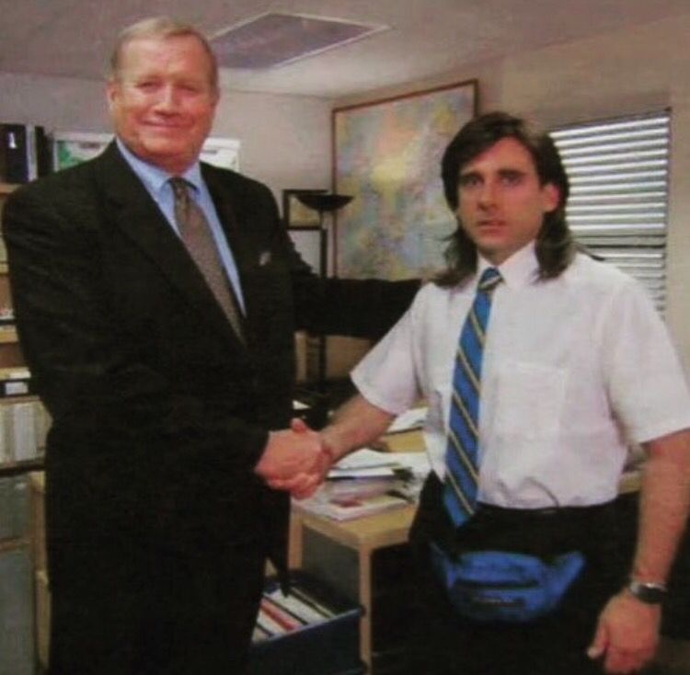

Problem: Michael Scott wants to create his own arcade video game
What is the situation?
Michael Scott
Michael created his own video game
What is the game?
A shooting game in which he can blast on Dunder Mifflin employees
Which problems does he need to solve?
Which publisher should he work with?
Which market should he target?
On what platform develop his game?
What genre should he label his game with?
How should he name his game?
What global sales can he expect?
Data Set
Review
Video Games
Market Analysis
Regression Analysis
Summary of
Key Findings

Slide 4
Extracted data contains video games sales, ratings and publishers information
How do we get the data?
Using 'scrapy' package in python we scraped the data from the vgchartz.com - online video games database
How does scraping work?
For each genre there is a list of video games and we scrape each genre to extract the video games belonging to it
Finally, we extract the data set on Video Games with the following features:
Video Games released from the year
1985 to 2016
Raw data contains information on
16 719 video games
The data set contains 17 variables:
Character Variables:
Name
Platform
Genre
Publisher
Developer
Rating
Numeric Variables:
Sales: Global, NA, EU, JP, Other
User Score
Critic Score
User Count
Critic Count
Year
After cleaning the data set, we end up with 7983 observations

Slide 5
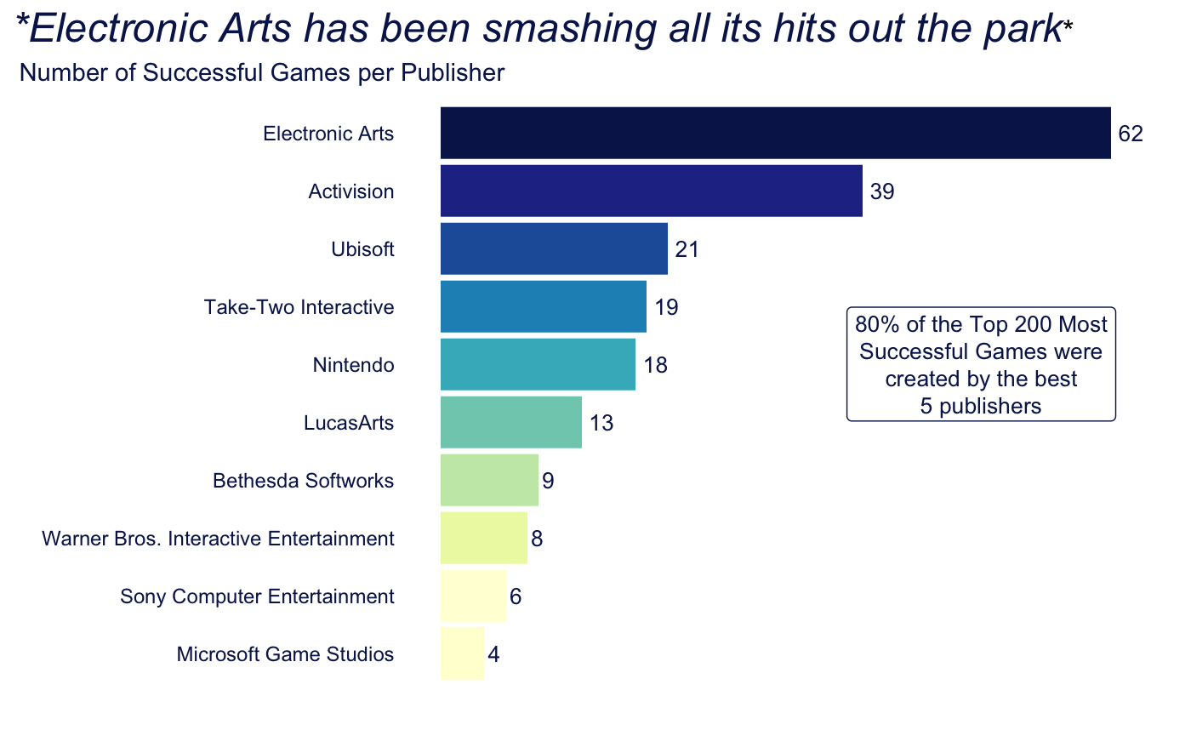
Electronic Arts has developed the highest number of popular video games
1. Which Publisher Should Michael Go With?
Michael wants to join the publisher that will get his game the hype it deserves
Success of the game is measured in terms of its global sales
We filtered the 200 most successful games of all time and derived the publishers’ success rates
Electronic Arts, Activision, Ubisoft, Take-Two Interactive, and Nintendo are the most successful publishers

Slide 6
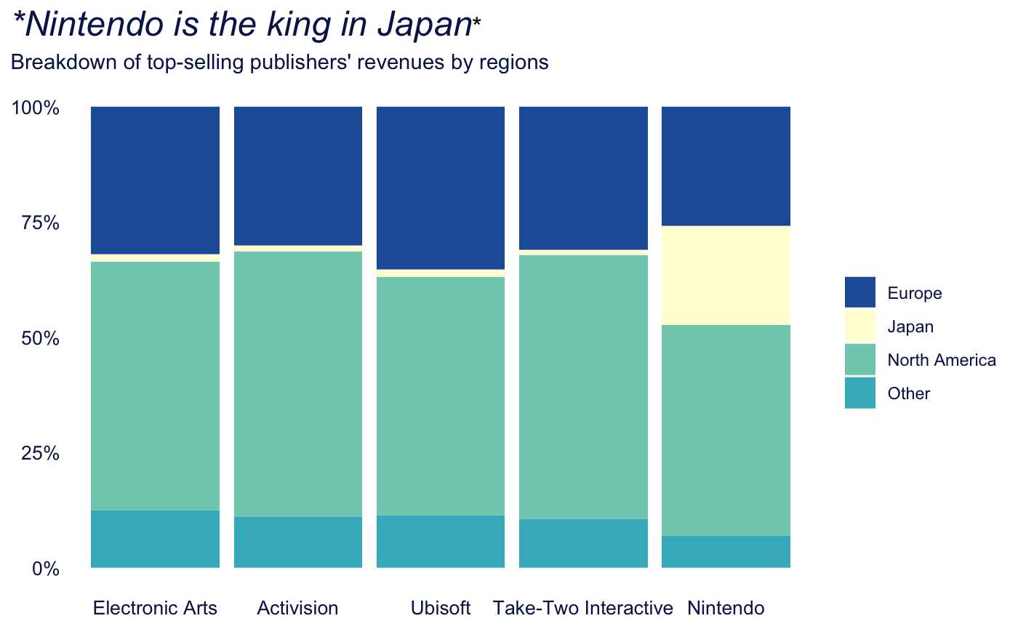
North America is the largest video games selling markets for all top publishers
2. What Regions Should Michael Target?
Michael should be conscious about the main geographical areas of activity of the publisher he joins
Acknowledging the regional sales distribution allows Michael to customize his marketing campaign
We computed a 100% staked bar chart of the break of geographical sales per publishers
North America and Europe are the largest markets for every publisher except for Nintendo (Japan)

Slide 7
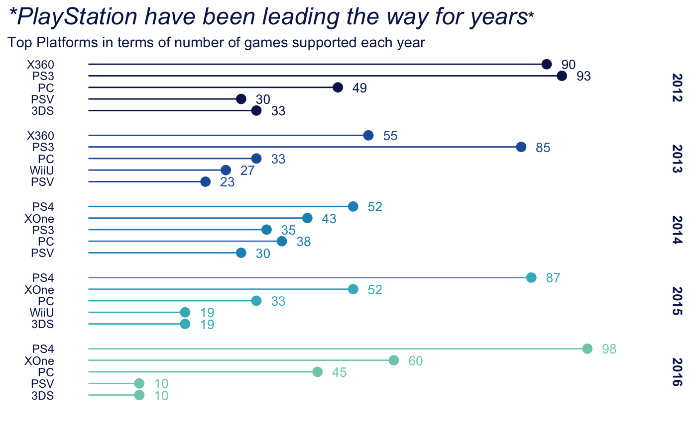
PlayStation continuously outperforms competition over the past years
3. On What Platform Should He Develop His Video Game?
Michael wants to join the platform which holds high sales record and number of users
Access to the video game is dependent on which platform it is available on
We visualise the platforms with the most supported games since 2012
PlayStation has been consistently beating competition since 2012

Slide 8
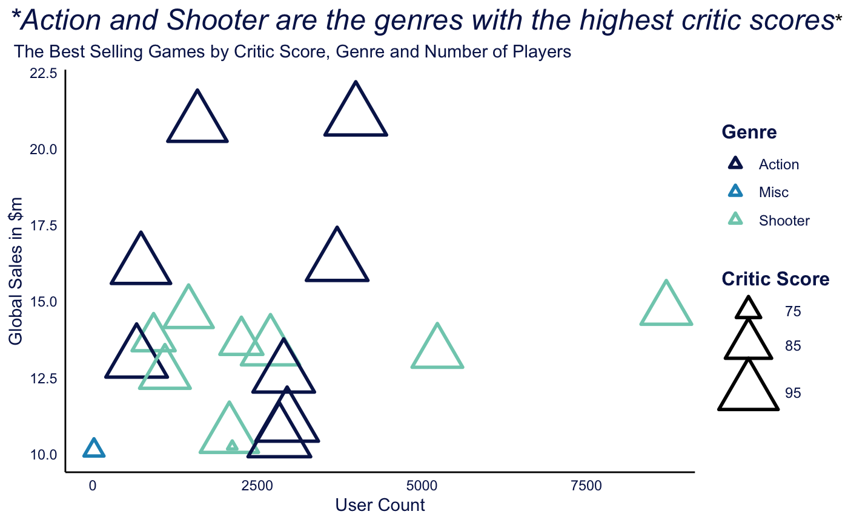
Action and Shooting games have the highest sales and the best ratings
4. What Genre Should He Label His Game With?
Michael should make sure the genre of his video game produces sufficient revenue
Michael also wants to check whether shooting game are well rated by users
We create a bubble chart displaying the most best selling games by critic score, genre and number of players
Action and shooting games have the best sales and ratings of the video games industry

Slide 9
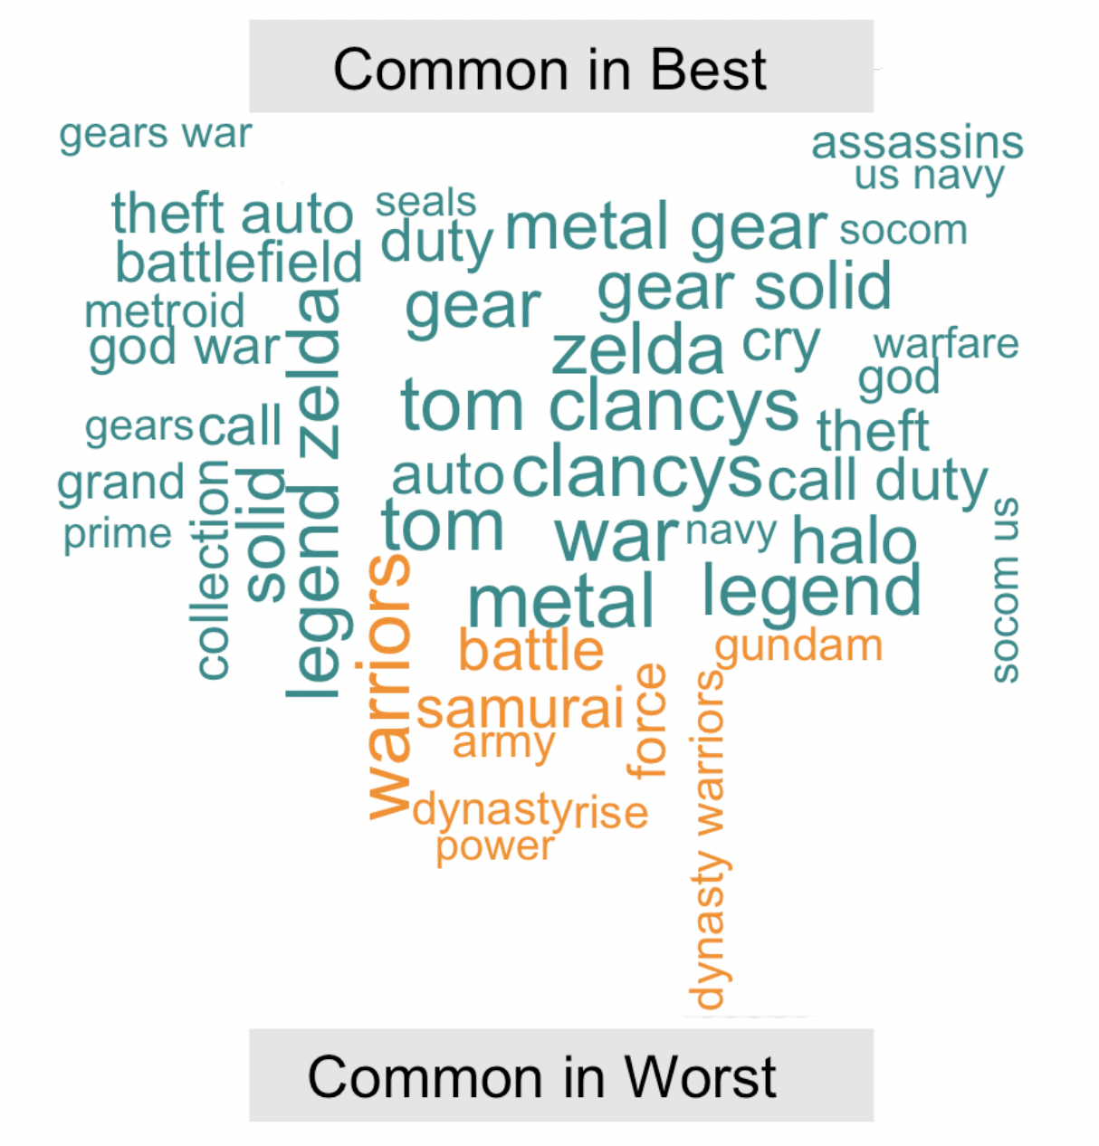
Michael should use words such as Legend, Metal or Gear in his title
5. How Should He Name His Video Game?
*Legend is among the most common words*
Video games name are an essential marketing component of the largest successes
Text mining analysis of shooting games title
Michael’s video game name must incorporate the most used words from the highest selling shooting games title
We use text mining techniques to analyse which words were most used in the best shooting games titles
Micheal should name his game:
‘Dunder War’

Slide 10
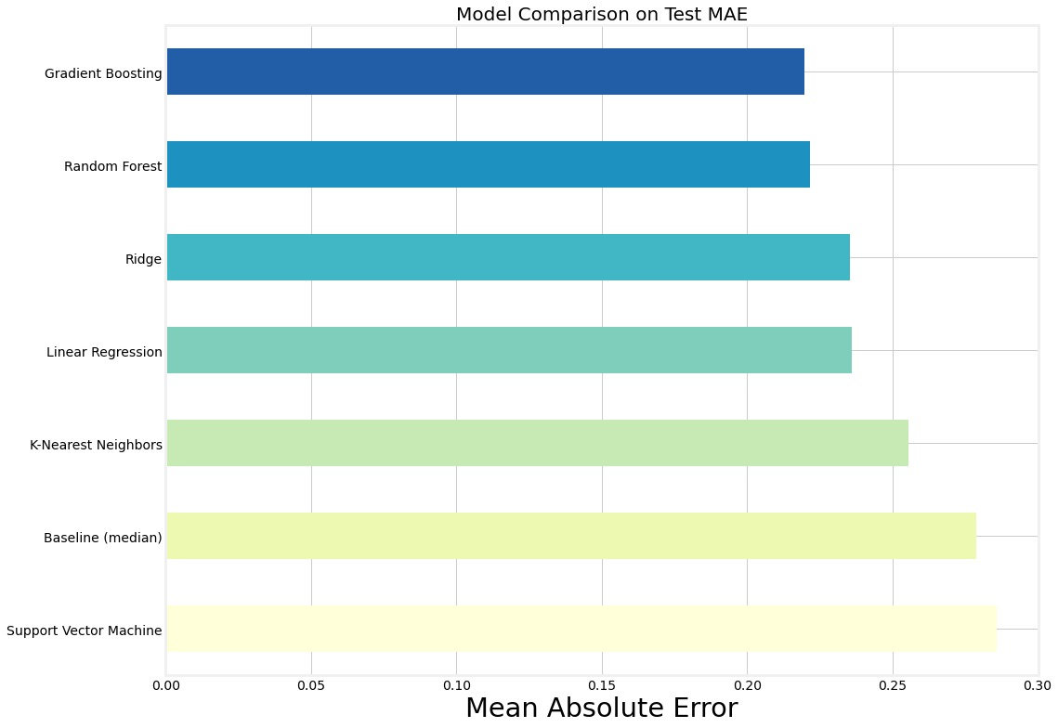
Of all regression techniques, Gradient Boosting is the best model to predict sales
6. What Global Sales Can He Expect?
How do we get the data?
Michael wants to find the best regression technique to predict global sales
Text mining analysis
We find that Gradient Boosting is the algorithm with the lowest MAE and therefore, the best model
Using Randomised Search to find the best parameters and Grid Search to find the best n estimators parameter
Michael can therefore name his game XXX
There is still some overfitting so we build a more advanced model!

Slide 11
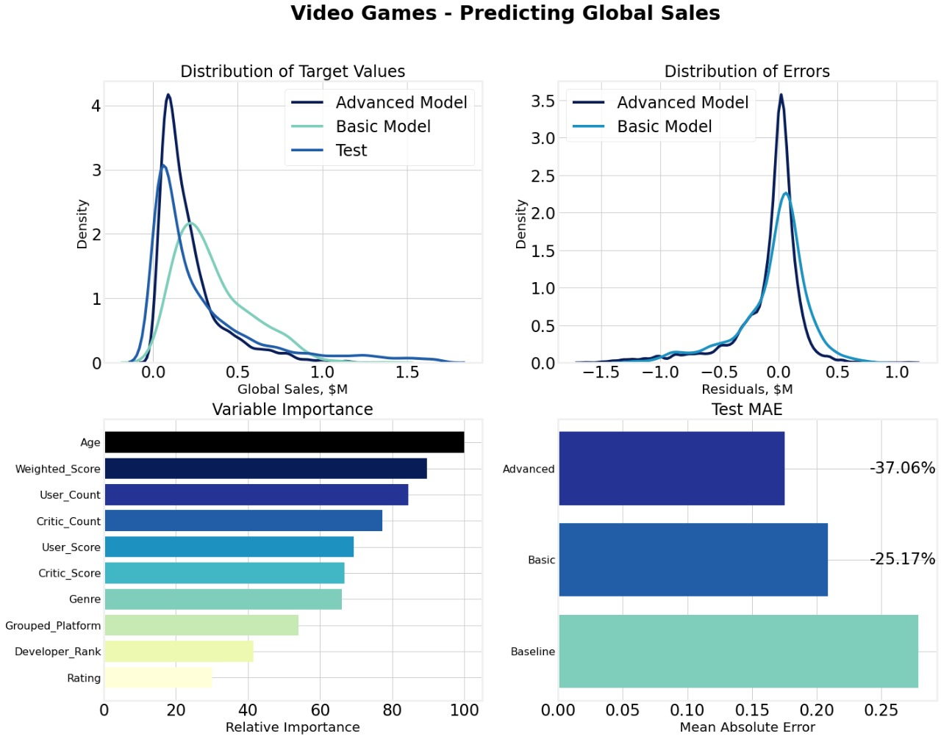
Age and Weighed Score have the most importance to predict global sales
6. What global sales can he expect?
Michael wants to reduce overfitting to build a better regression model
We perform Feature Engineering and Feature Selection on the dataset
Impute missing values and use ordinal encoding before Gradient Boosting and Hyperparameter Optimization
Advanced model yields lower MAE on the testing set but still overfits and there is room for some improvement

Slide 12

Michael Scott business plan is now quite clear!
Question | Features | Michael Scott’s Video Game
1. | Publisher | Ubisoft
2. | Platform | All platforms
3. | Geographical Market | North America
4. | Genre | Shooter
5. | Name of the video game | “Dunder War”
6. | Predicted Yearly Sales | $387,000

